Slide 1
Focus On Malachi

Slide 2
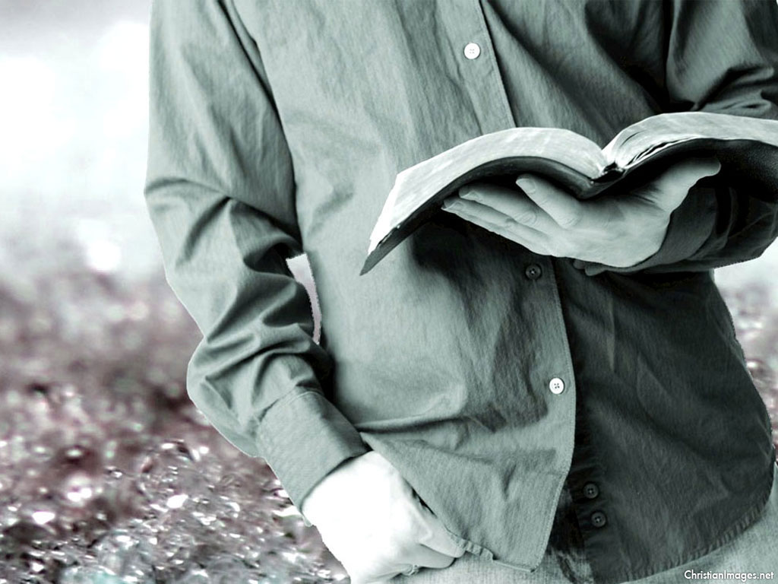
The Title & The Backdrop
“ Returning to your First Love”
The Israelites had returned from the Babylonian exile. Jerusalem had been rebuilt, and the temple restored.
But the people had not learned their lesson from the exile. They had grown doubtful of God's love (Mal 1:2).
“I have loved you,” says the Lord. “But you ask, ‘How have you loved us?’ “Was not Esau Jacob’s brother?” declares the Lord. “Yet I have loved Jacob.

Slide 3
“ Returning to your First Love”
The great temptation for Israel in the Old Testament and for the modern church today is to forget that we are pilgrims not citizens in this world.
The Israelites had returned from the Babylonian exile. Jerusalem had been rebuilt, and the temple restored. But the people had not learned their lesson from the exile. They had grown doubtful of God's love (Mal 1:2)

Slide 4
Remember His Love
Malachi’s message begins by addressing that every departure from God begins - in the heart. The people of Judah lost appreciation of God’s love for them.
They have forgotten their past covenant

Slide 5
Remember His Mercy
Malachi 2:10
Do we not all have one Father? Did not one God create us? Why do we profane the covenant of our ancestors by being unfaithful to one another?
The Prophet challenges us to Remember His Mercy and Reevaluate Our Faithfulness. God is merciful so shall we.

Slide 6
Remember He Gave First
I John 4:19 “We love because he first loved us.”
The Basis of our Giving is love that is because God had demonstrated His Love first.
Tithing is one of the main theme in Malachi. Just like God revealed his love to us He expects nothing less of our love and devotion to Him.

Slide 7
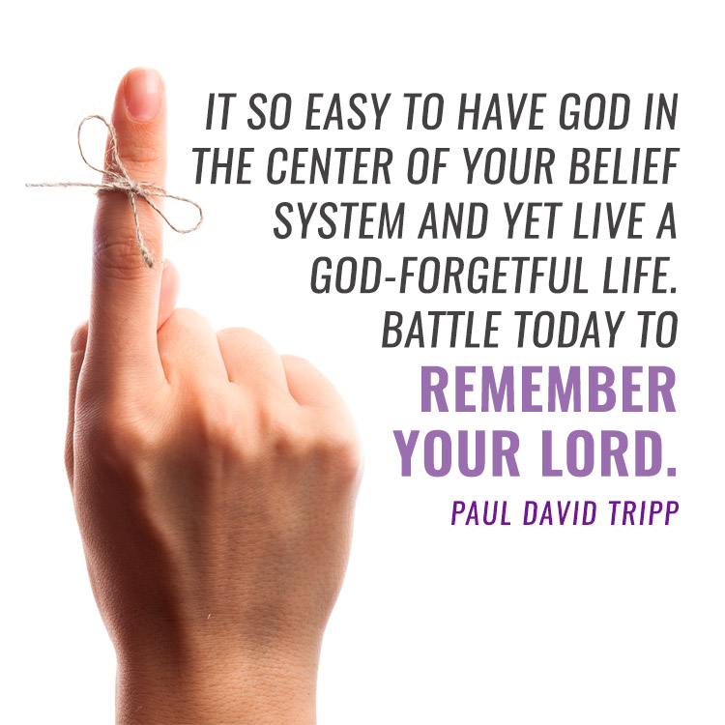

Slide 8
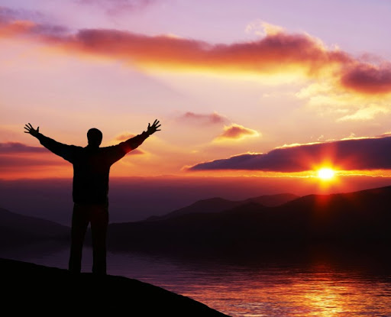
Closing
Malachi 4:2
But for you who revere my name, the sun of righteousness will rise with healing in its rays. And you will go out and frolic like well-fed calves.
There is exciting hope for those who fear and trust in God. He will arise as the Sun of righteousness, and heal us and make us strong again

Slide 9
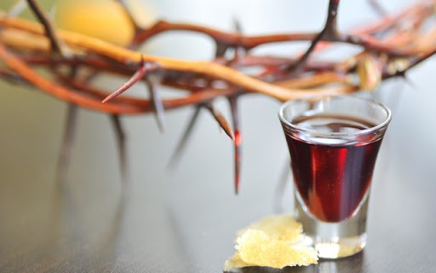
COMMUNION SERVICE
Hold the Bread and the Cup with Thanksgiving in your hearts.
John 6:35 Then Jesus declared,
“I am the bread of life. Whoever comes to me will never go hungry, and whoever believes in me will never be thirsty.
Hold the Bread and the Cup with Thanksgiving in your hearts.

