Slide 1
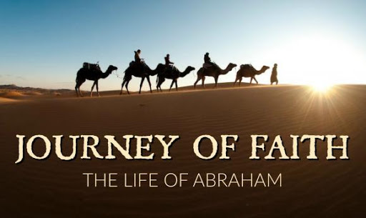

Slide 2
Genesis 22:1-19
Now it came to pass after these things that God tested Abraham, and said to him, “Abraham!” And he said, “Here I am.” ² Then He said, “Take now your son, your only son Isaac, whom you love, and go to the land of Moriah, and offer him there as a burnt offering on one of the mountains of which I shall tell you.” ³ So Abraham rose early in the morning and saddled his donkey, and took two of his young men with him, and Isaac his son; and he split the wood for the burnt offering, and arose and went to the place of which God had told him. ⁴ Then on the third day Abraham lifted his eyes and saw the place afar off. ⁵ And Abraham said to his young men, “Stay here with the donkey; the lad and I will go yonder and worship, and we will come back to you.” ⁶ So Abraham took the wood of the burnt offering and laid it on Isaac his son; and he took the fire in his hand, and a knife, and the two of them went together.

Slide 3
⁷ But Isaac spoke to Abraham his father and said, “My father!” And he said, “Here I am, my son.” Then he said, “Look, the fire and the wood, but where is the lamb for a burnt offering?” ⁸ And Abraham said, “My son, God will provide for Himself the lamb for a burnt offering.” So the two of them went together. ⁹ Then they came to the place of which God had told him. And Abraham built an altar there and placed the wood in order; and he bound Isaac his son and laid him on the altar, upon the wood. ¹⁰ And Abraham stretched out his hand and took the knife to slay his son.
¹¹ But the Angel of the Lord called to him from heaven and said, “Abraham, Abraham!” So he said, “Here I am.” ¹² And He said, “Do not lay your hand on the lad, or do anything to him; for now I know that you fear God, since you have not withheld your son, your only son, from Me.”

Slide 4
¹³ Then Abraham lifted his eyes and looked, and there behind him was a ram caught in a thicket by its horns. So Abraham went and took the ram, and offered it up for a burnt offering instead of his son. ¹⁴ And Abraham called the name of the place, The-Lord-Will-Provide; as it is said to this day, “In the Mount of the Lord it shall be provided.” ¹⁵ Then the Angel of the Lord called to Abraham a second time out of heaven, ¹⁶ and said: “By Myself I have sworn, says the Lord, because you have done this thing, and have not withheld your son, your only son— ¹⁷ blessing I will bless you, and multiplying I will multiply your descendants as the stars of the heaven and as the sand which is on the seashore; and your descendants shall possess the gate of their enemies. ¹⁸ In your seed all the nations of the earth shall be blessed, because you have obeyed My voice.” ¹⁹ So Abraham returned to his young men, and they rose and went together to Beersheba; and Abraham dwelt at Beersheba.

Slide 5
Abraham’s False Starts
False Start 1
Yielded Sarah up in Egypt : Pharaoh
Genesis 12
False Start 2
Yielded Sarah up in Gerar : Abimelek
Genesis 20
False Start 3
Produced an heir through Hagar
Genesis 16

Slide 6
Abraham’s Positive Lessons
AUTHENTIC SPIRITUALITY
OBEDIENCE
BURDEN FOR THE LOST
GENEROSITY

Slide 7
Lessons from The Journey of Faith
God sees all
God senses our needs
God stamps His approval

